Slide 1
RESEARCH DESIGN

Slide 2
What is Research design and what balancing act is to be done when we formulate a research design?
Research design is a framework or blueprint for conducting a research project. It specifies the details of the procedures necessary for obtaining the information needed to solve research problems.
In formulating a research design, the researcher has to balance the perspectives of the decision-makers and target respondents.

Slide 3
Research design from the decision-makers’ perspective
Decision-makers expect information that is:
Accurate, Current, Sufficient, Available, Relevant
Generating information that fulfils all the above characteristics given the restriction of budget and timescale is extremely difficult.

Slide 4
Research design from the respondents’ perspective
The potential respondents to any research investigation play a vital role in deciding which research design will actually work in practice.
Researchers must understand
Characteristics of respondents,
How they react to particular issues and
How they react in different contexts or environments.

Slide 5
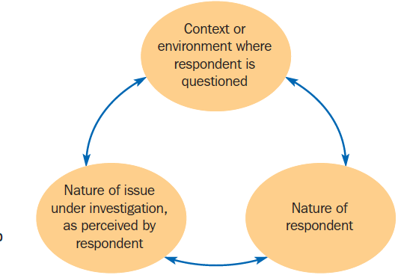
Understanding respondents – to help choose optimum research techniques

Slide 6
To understand specialized subpopulations, e.g. video gamers, horse lovers, or jobseekers, it is vital to reach people in the context of their specialization.
Researchers should visit the places where people live this part of their identity; read their newsletters; visit their chat rooms; and attend their conventions.
Talk to those who deal with the subpopulation on a regular basis.
To understand students, interview teachers; to understand drivers, talk to traffic police; and so on.

Slide 7
RESEARCH DESIGN CLASSIFICATION

Slide 8
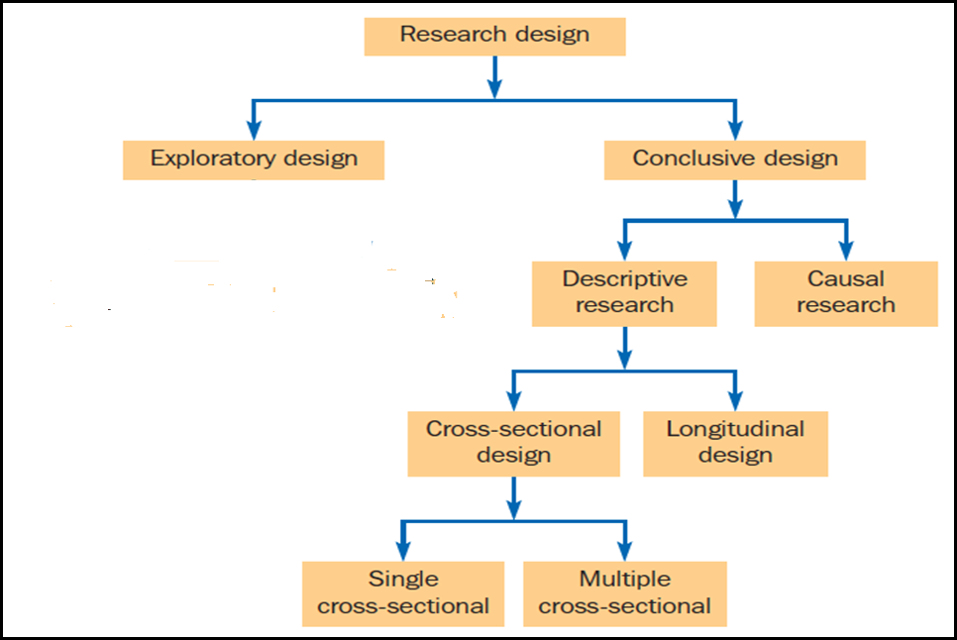
Important
A CLASSIFICATION OF RESEARCH DESIGNS

Slide 9
What is Exploratory research and when is it used?
Exploratory research is meaningful in any situation where the researcher does not have enough understanding to proceed with the research project.
Exploratory research is characterized by flexibility and versatility with respect to the methods, because formal research protocols and procedures are not employed. It rarely involves structured questionnaires, large samples and probability sampling plans. Rather, researchers are alert to new ideas and insights as they proceed.
Creativity and ingenuity of the researcher play a major role in exploratory research.

Slide 10
To obtain some background information where absolutely nothing is known about the problem area
To define problem areas fully and to formulate hypotheses for further investigation and/or quantification
To explore issues that respondents may hold deeply, that are difficult for them to rationalize and that they may find difficult to articulate
To explore sensitive or personally embarrassing issues from the respondents’ and/or the interviewer’s perspective
To identify and explore concepts in the development of new product or forms of marketing communications
A SUMMARY OF THE USES OF EXPLORATORY DESIGN

Slide 11
What is Conclusive research and when it is used?
A research design characterized by the measurement of clearly defined phenomena.
The objective of conclusive research is to describe specific phenomena, to test specific hypotheses and to examine specific relationships. This requires that the information needed is clearly specified.
Conclusive research is typically more formal and structured than exploratory research. It is based on large, representative samples, and the data obtained are subjected to quantitative analysis.
Conclusive research designs may be either descriptive or causal, and descriptive research designs may be either cross-sectional or longitudinal.

Slide 12
To describe the characteristics of relevant groups, such as consumers, salespeople, organizations, or market areas
To estimate the percentage in a specified population exhibiting a certain form of behaviour
To count the frequency of events, especially in the patterns of consumer behaviour
To measure marketing phenomena to represent larger populations or target markets
To measure marketing phenomena in a consistent and universal manner
To determine the degree to which marketing variables are associated
To make specific predictions
A SUMMARY OF THE USES OF CONCLUSIVE DESIGN

Slide 13
What is Descriptive research when it is used?
A type of conclusive research that has as its major objective the description of something.
A major difference between exploratory and descriptive research is that descriptive research is characterized by the prior formulation of specific research questions and hypotheses. Thus, the information needed is clearly defined. As a result, descriptive research is preplanned and structured. It is typically based on large representative samples.

Slide 14
A descriptive research design specifies the methods for selecting the sources of information and for collecting data from those sources.
Examples of descriptive studies in marketing research are as follows:
Market studies describing the size of the market, buying power of the consumers, availability of distributors, and consumer profiles.
Market share studies determining the proportion of total sales received by a company and its competitors.
Sales analysis studies describing sales by geographic region, product line, type of account and size of account.
Image studies determining consumer perceptions of the firm and its products.
Product usage studies describing consumption patterns.
Distribution studies determining traffic flow patterns and the number and location of distributors.
Pricing studies describing the range and frequency of price changes and probable consumer response to proposed price changes.
Advertising studies describing media consumption habits and audience profiles for specific TV programmes and magazines.

Slide 15
Cross-sectional designs
Cross-sectional designs involve the collection of information from any given sample of population elements only once.
They may be either single cross-sectional or multiple cross-sectional
In single cross-sectional designs, only one sample of respondents is drawn from the target population, and information is obtained from this sample only once.
In multiple cross-sectional designs, there are two or more samples of respondents, and information from each sample is obtained only once.

Slide 16
Longitudinal design
A type of research design involving a fixed sample of population elements measured repeatedly. The sample remains the same over time, thus providing a series of pictures that, when viewed together, vividly illustrate the situation and the changes that are taking place.

Slide 17
CAUSAL RESEARCH
Causal research is used to obtain evidence of cause-and-effect (causal) relationships.
Causal research is appropriate for the following purposes:
To understand which variables are the cause (independent variables) and which variables are the effect (dependent variables).
To determine the nature of the relationship between the causal variables and the effect to be predicted.

Slide 18
Like descriptive research, causal research requires a planned and structured design. Although descriptive research can determine the degree of association between variables, it is not appropriate for examining causal relationships.
Such an examination requires a causal design, in which the causal or independent variables are manipulated in a relatively controlled environment. Such an environment is one in which the other variables that may affect the dependent variable are controlled or checked as much as possible. The effect of this manipulation on one or more dependent variables is then measured to infer causality.
The main method of causal research is experimentation.

Slide 19
RELATIONSHIPS BETWEEN EXPLORATORY, DESCRIPTIVE AND CAUSAL RESEARCH
We have described exploratory, descriptive and causal research as major classifications of research designs, but the distinctions among these classifications are not absolute.
A given marketing research project may involve more than one type of research design and thus serve several purposes. Which combination of research designs to employ depends on the nature of the problem. The following general guidelines can be used for choosing research designs.
When little is known about the problem situation, it is desirable to begin with exploratory research. Exploratory research is appropriate for the following:
When the nature of the topic under study cannot be measured in a structured, quantifiable manner.
When the problem needs to be defined more precisely.
When alternative courses of action need to be identified.
When research questions or hypotheses need to be developed.

Slide 20
Exploratory research may be an initial step in a research design. It may be followed by descriptive or causal research. For example, hypotheses developed via exploratory research can be statistically tested using descriptive or causal research.
It is not necessary to begin every research design with exploratory research. It depends on the precision with which the problem has been defined and the researcher’s degree of certainty about the approach to the problem. A research design could well begin with descriptive or causal research. To illustrate, a consumer satisfaction survey that is conducted annually need not begin with or include an exploratory phase.

Slide 21
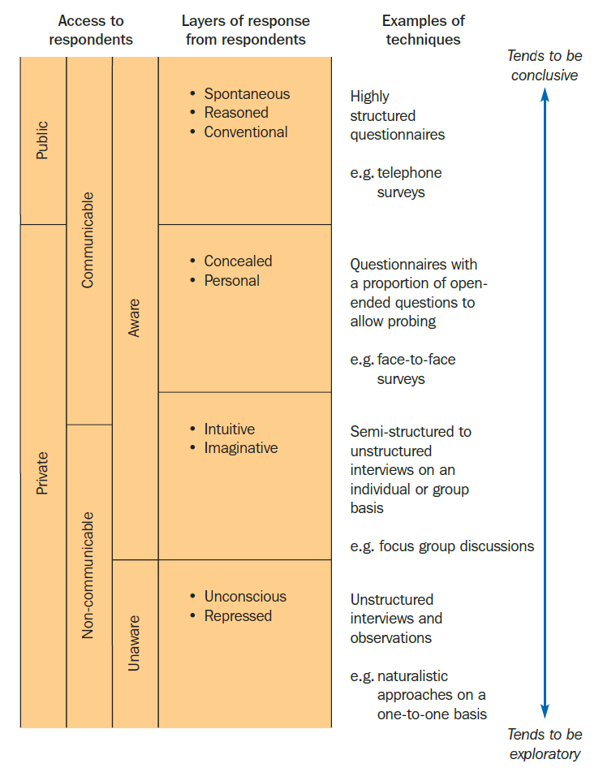

Slide 22
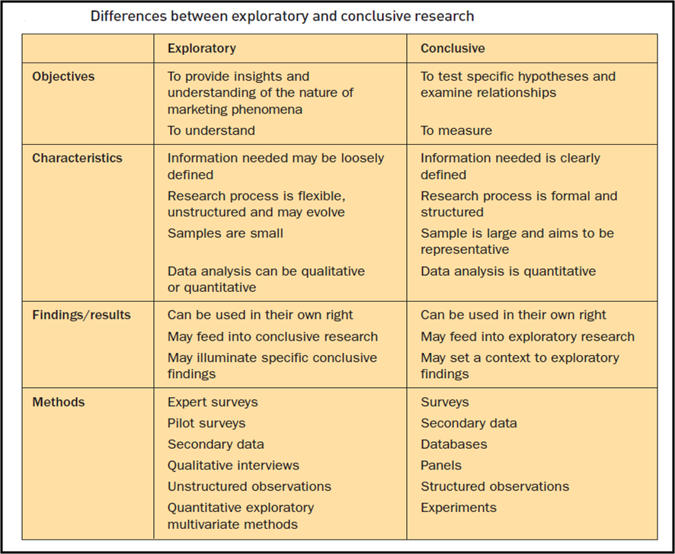

Slide 23
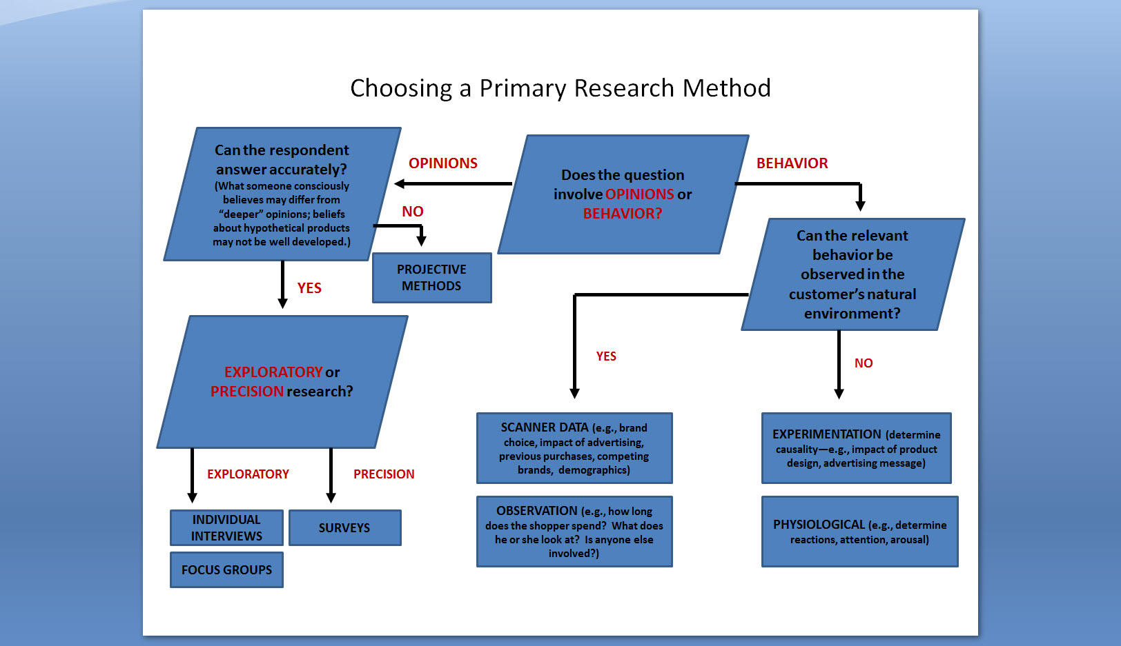

Slide 24
ERRORS IN RESEARCH

Slide 25
Potential sources of error in research designs
Several potential sources of error can affect a research design. A good research design attempts to control the various sources of error.
As shown in Figure , total error is composed of random sampling error and non-sampling error.

Slide 26
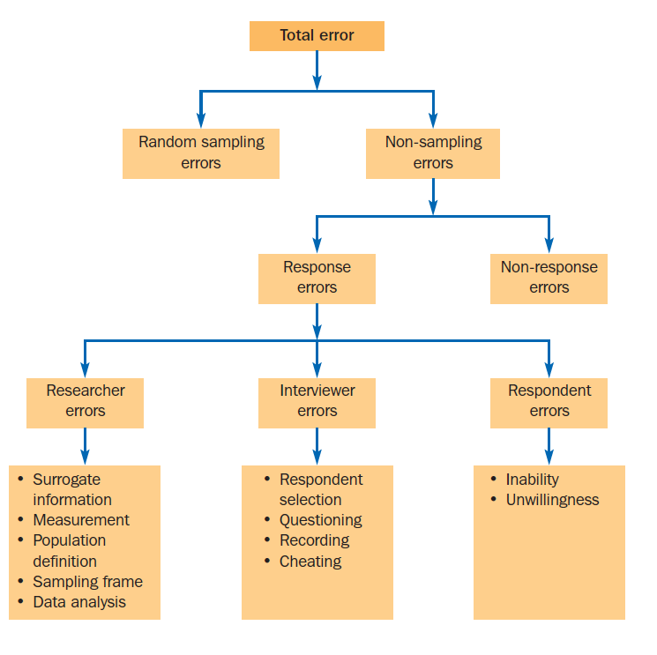
Important
Potential sources of error in research designs

Slide 27
Total error
The total error is the variation between the true mean value in the population of the variable of interest and the observed mean value obtained in the research project.
For example, the annual average income of a target population may be Rs 85,650/-, as determined from census information via tax returns, but research project estimates it at Rs 62,580/- based upon a sample survey.
Random sampling error
The error arising because the particular sample selected is an imperfect representation of the population of interest. Random sampling error is the variation between the true mean value for the population and the true mean value for the original sample.
Randomness could not be designed

Slide 28
Non-sampling error
Non-sampling errors can be attributed to sources other than sampling. They result from a variety of reasons, including errors in problem definition, approach, scales, questionnaire design, interviewing methods, and data preparation and analysis. Non-sampling errors consist of non-response errors and response errors.
Non-response error
A non-response error arises when some of the respondents included in the sample do not respond. The primary causes of non-response are refusals and not-at-homes. Non-response will cause the net or resulting sample to be different in size or composition from the original sample. Non-response error is defined as the variation between the true mean value of the variable in the original sample and the true mean value in the net sample.

Slide 29
Response error
Response error arises when respondents give inaccurate answers or their answers are misrecorded or misanalysed. Response error is defined as the variation between the true mean value of the variable in the net sample and the observed mean value obtained in the research project.
For example, the annual average income is Rs 69467/- for the net sample, but is estimated as Rs 67157/- in the research project estimate.
Response error can be made by researchers, interviewers, or the respondent.

Slide 30
Surrogate information error may be defined as the variation between the information needed for the research problem and the information sought by the researcher. For example, instead of obtaining information on consumer choice of a new brand , the researcher obtains information on consumer preferences.
Measurement error may be defined as the variation between the information sought and information generated by the measurement process employed by the researcher. While seeking to measure consumer preferences, the researcher employs a instrument that measures perceptions rather than preferences.
Population definition error may be defined as the variation between the actual population relevant to the problem at hand and the population as defined by the researcher.

Slide 31
Sampling frame error
Sampling frame error may be defined as the variation between the population defined by the researcher and the population as implied by the sampling frame (list) used. For example, the telephone directory used to generate a list of telephone numbers does not accurately represent the population of potential landline consumers due to unlisted, disconnected and new numbers in service. It also misses out the great number of consumers who choose not to have landlines, exclusively using mobile telephones
Data analysis error
Data analysis error encompasses errors that occur while raw data from questionnaires are transformed into research findings. For example, an inappropriate statistical procedure is used, resulting in incorrect interpretation and findings.

Slide 32
Respondent selection error occurs when interviewers select respondents other than those specified by the sampling design. For example, in a readership survey, a non-reader is selected for the interview but classified as a reader of Le Monde in the 15–19-year-old category in order to meet a difficult quota requirement.
Questioning error denotes errors made in asking questions to the respondents or in not probing, when more information is needed. For example, while asking questions an interviewer does not use the exact wording or prompts as set out in the questionnaire.
Recording error arises due to errors in hearing, interpreting and recording the answers given by the respondents. For example, a respondent indicates a neutral response (undecided) but the interviewer misinterprets that to mean a positive response (would buy the new brand).
Cheating error arises when the interviewer fabricates answers to a part or the whole of the interview. For example, an interviewer does not ask the sensitive questions related to a respondent’s debt but later fills in the answers based on personal assessment.

Slide 33
Inability error results from the respondent’s inability to provide accurate answers. Respondents may provide inaccurate answers because of unfamiliarity, fatigue, boredom, faulty recall, question format, question content and other factors. For example, a respondent cannot recall the brand of toothpaste purchased four weeks ago.
Unwillingness error arises from the respondent’s unwillingness to provide accurate information. Respondents may intentionally misreport their answers because of a desire to provide socially acceptable answers, to avoid embarrassment, or to please the interviewer. For example, to impress the interviewer, a respondent intentionally says that they read The Economist magazine.

Slide 34
THANK YOU

Slide 35
Extra for Knowledge

Slide 36
There is an exception to exploratory designs being built around qualitative techniques. There are examples of quantitative findings being used for exploratory purposes.
For example, within a survey that examines specific research questions and hypotheses lies the opportunity to examine additional connections between questions that had not been initially considered. Simple correlations through to multivariate techniques that explore potential connections between questions may be conducted; this process is known as data mining.
In essence, data mining searches for significant connections or patterns in a dataset that a researcher or decision-maker may be unaware of

Slide 37
Although exploratory research is generally the initial step, it need not be.
Exploratory research may follow descriptive or causal research. For example, descriptive or causal research results in findings that are hard for managers to interpret. Exploratory research may provide more insights to help understand these findings.

Slide 38
In formulating a research design, the researcher should attempt to minimize the total error, not just a particular source.
This admonition is warranted by the general tendency among naive researchers to control sampling error with large samples. Increasing the sample size does decrease sampling error, but it may also increase non -sampling error, e.g. by increasing interviewer errors. Non sampling error is likely to be more problematic than sampling error.
Sampling error can be calculated, whereas many forms of non-sampling error defy estimation. Moreover, non-sampling error has been found to be the major contributor to total error, whereas random sampling error is relatively small in magnitude. The point is that total error is important. A particular type of error is important only in that it contributes to total error.

Slide 39
Sometimes, researchers deliberately increase a particular type of error to decrease the total error by reducing other errors.
For example, suppose that a mail survey is being conducted to determine consumer preferences in purchasing shoes from a chain of specialist shoe shops. A large sample size has been selected to reduce sampling error. A response rate of 30% may be expected. Given the limited budget for the project, the selection of a large sample size does not allow for follow-up mailings. Past experience, however, indicates that the response rate could be increased to 45% with one follow-up mailing and to 55% with two follow-up mailings. Given the subject of the survey, non-respondents are likely to differ from respondents in many features. Hence, it may be desirable to reduce the sample size to make money available for follow-up mailings. While decreasing the sample size will increase random sampling error, the two follow-up mailings will more than offset this loss by decreasing non-response error.

